Slide 1


Understanding Yelp Text and Star Reviews for Business Success
Springboard Capstone Project 2
Gurdeep Sullan
6/2/2020

Slide 2
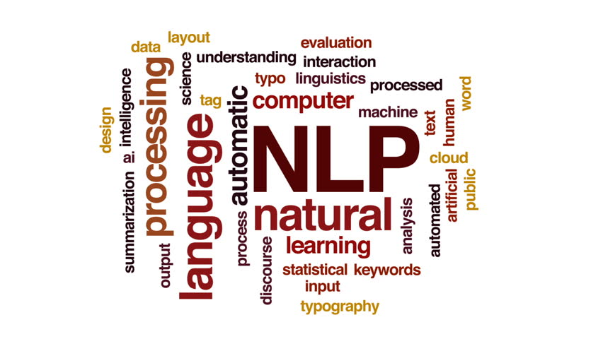
Background
Why do Sentiment Analysis?
We can understand sentiment towards a business or subject given text data
This is important for understanding business success and interpreting feedback
NLP analysis can produce models that can be interpreted for important keywords that determine sentiment

Slide 3
Problem Statement
There is a large amount of text review data that is connected to businesses on Yelp.
Can we build a model to accurately predict sentiment of reviews (using the star rating as labels)?
Can we find meaningful words in reviews that correlate highly with success in star rating?

Slide 4
Data Sources
Yelp dataset on Kaggle:
https://www.kaggle.com/yelp-dataset/yelp-dataset
The project specifically uses two of the json files in this dataset:
Yelp_academic_dataset_business.json
Yelp_academic_dataset_review.json
Data from businesses in 11 metropolitan areas located in 4 countries. There are 5,200,000 user reviews and information on 174,000 businesses.
Tensorflow dataset:
https://www.tensorflow.org/datasets/catalog/yelp_polarity_reviews#yelp_polarity_reviewsplain_text_default_config
This dataset has 560,000 highly polar yelp reviews in its training set, and 38,000 highly polar yelp reviews in its test set.

Slide 5
Feature Engineering and Creating a label
A feature from the business dataset, avg_star_rating, was joined to the user reviews
Additionally, ‘sentiment’ was a label created from the individual ‘star_rating’ using a criteria:
star_rating <=3 : Negative
star_rating > 3 : Positive

Slide 6
NLP Approaches
Raw text column will be preprocessed by applying (.apply()) custom functions to strip punctuation, non-English characters, and numbers from the raw text.
Spacy will be the NLP library used for text analysis
The clean text is input into one of three pipelines depending on the NLP approach, after a train-test split with a test_size=0.1:
Bag of Words (BOW) Approach: TfidfVectorizer
BOW + Singular Value Decomposition (SVD) Approach: TfidfVectorizer and TruncatedSVD
Word Embedding Approach: Spacy.doc.vector

Slide 7
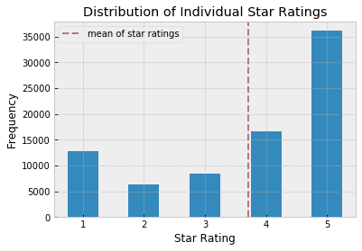
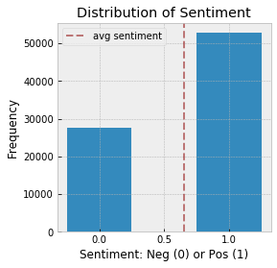
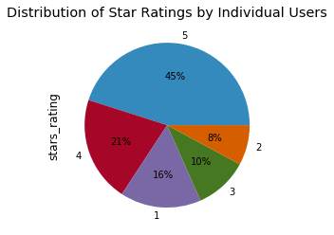
EDA - Star Ratings & Sentiment
Create label ‘sentiment’ based on criteria

Slide 8
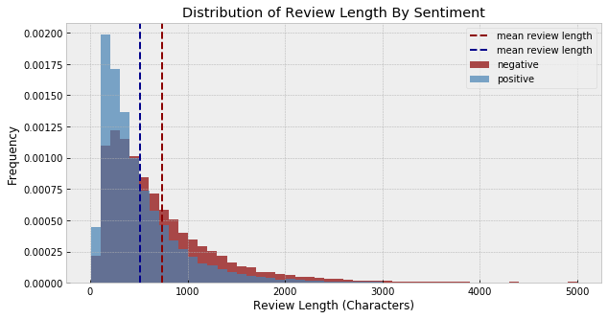
EDA - Review Length
Review Length (in characters) seems to be different for positive vs negative reviews in general

Slide 9
Machine Learning Models
Logistic Regression
Random Forest
LinearSVC
MultinomialNB
GaussianNB
RNN

Slide 10
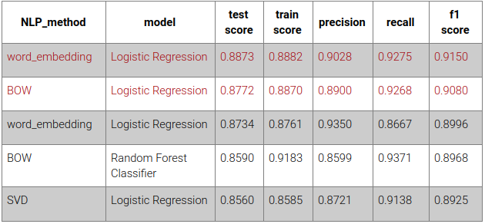
Model Evaluation & Comparison
Looking at the best performing models based on f1 score, Logistic Regression Classifier works very well for this dataset
The word embedding method performed the best across all metrics
The bag-of-words method did come in as a close second

Slide 11
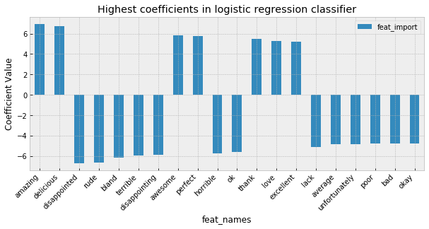
Model Interpretation
We can interpret our logistic regression model on the BOW approach, where each coefficient corresponds to a word in user reviews.

Slide 12
Conclusions and Future Directions
The BOW approach takes less computing resources during NLP processing, but resultant dimensionality of data can make training ML models slow
In contrast, word embedding method using spacy takes more time during NLP, but yields a fixed 300-dimension vector that makes training of ML models generally faster than the BOW approach.
Both approaches are valid and produce a ~90% test accuracy with a high f1 score
There is an additional dataset from the Kaggle data competition that includes business data.
Future work will focus on NLP of the business attributes in the business dataset and predicting overall star rating based on those attributes.

Slide 13
Acknowledgements
Springboard
Hobson Lane
Clip art:
https://www.analyticsvidhya.com/blog/2017/10/essential-nlp-guide-data-scientists-top-10-nlp-tasks/
Yelp.com
https://www.google.com/url?sa=i&url=http%3A%2F%2Fclipart-library.com%2Fdrinks-food-cliparts.html&psig=AOvVaw2UvAQSOIMb8vfoXKDyp5vL&ust=1591254882643000&source=images&cd=vfe&ved=0CAMQjB1qFwoTCMCp1MqM5ekCFQAAAAAdAAAAABAD

